Slide 1
Object Oriented Software Engineering (OOSE)
22CS017
Design Engineering
Prepared by: Dr. Bhavna Sareen

Slide 2
Index
Design concepts and model
Data design
Architectural design
Design class based components
User interface analysis and its design
Interface analysis and interface design steps

Slide 3
Introduction
Software design encompasses the set of principles, concepts, and practices that lead to the development of a high-quality system or product.
Design principles establish an overriding philosophy that guides you in the design work you must perform.
Design is pivotal to successful software engineering
The goal of design is to produce a model or representation that exhibits:
Firmness: A program should not have any bugs that inhibit its function.
Commodity: A program should be suitable for the purposes for which it was intended.
Delight: The experience of using the program should be a pleasurable one
Software design changes continually as new methods, better analysis, and broader understanding evolve.

Slide 4
Introduction
The importance of software design can be stated with a single word quality.
Design is the place where quality is fostered in software engineering.
Design provides you with representations of software that can be assessed for quality.
Design is the only way that you can accurately translate stakeholder’s requirements into a finished software product or system.
Software design serves as the foundation for all the software engineering and software support activities that follow.
Without design, you risk building an unstable system—one that will fail when small changes are made; one that may be difficult to test; one whose quality cannot be assessed until late in the software process, when time is short and many dollars have already been spent.

Slide 5
Design within the Context of Software Engineering
Software design sits at the technical kernel of software engineering and is applied regardless of the software process model that is used.
Beginning once software requirements have been analyzed and modeled, software design is the last software engineering action within the modeling activity and sets the stage for construction (code generation and testing).
Each of the elements of the requirements model provides information that is necessary to create the four design models required for a complete specification of design.
The flow of information during software design is illustrated in figure 1.
The requirements model, manifested by scenario-based, class-based, flow-oriented, and behavioral elements, feed the design task.

Slide 6
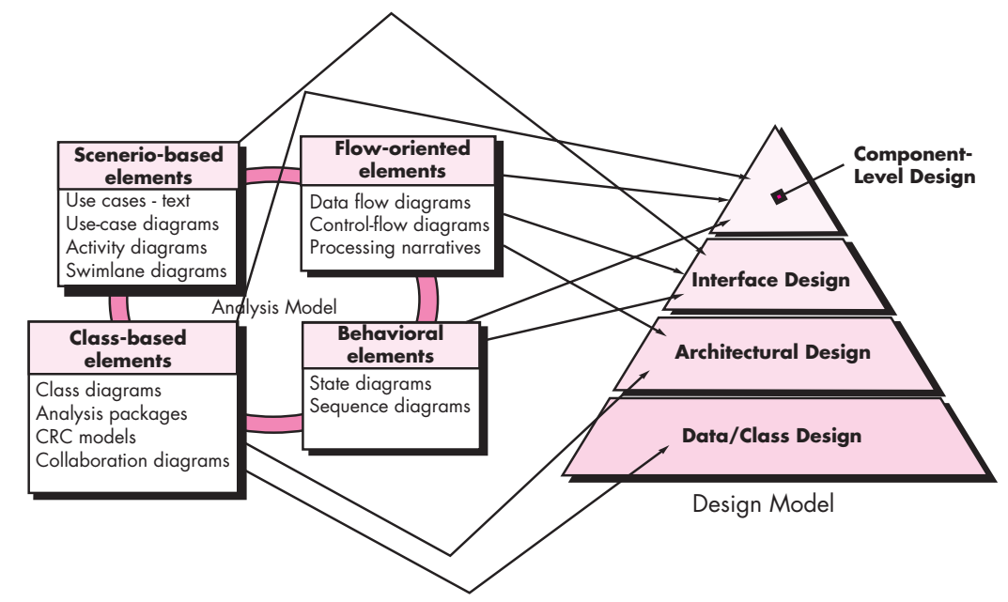
Design within the Context of Software Engineering (contd.)
Figure 1: Translating the requirements model into the design model

Slide 7
Design within the Context of Software Engineering (contd.)
The data/class design transforms class models into design class realizations and the requisite data structures required to implement the software.
The architectural design defines the relationship between major structural elements of the software, the architectural styles and design patterns that can be used to achieve the requirements defined for the system, and the constraints that affect the way in which architecture can be implemented.
The architectural design representation the framework of a computer- based system is derived from the requirements model.

Slide 8
Design within the Context of Software Engineering (contd.)
The interface design describes how the software communicates with systems that interoperate with it, and with humans who use it.
An interface implies a flow of information (e.g., data and/or control) and a specific type of behavior.
Therefore, usage scenarios and behavioral models provide much of the information required for interface design.
The component-level design transforms structural elements of the software architecture into a procedural description of software components.
Information obtained from the class-based models, flow models, and behavioral models serve as the basis for component design.

Slide 9
The Design Process
Software design is an iterative process through which requirements are translated into a “blueprint” for constructing the software.
Initially, the blueprint depicts a holistic view of software.
That is, the design is represented at a high level of abstraction— a level that can be directly traced to the specific system objective and more detailed data, functional, and behavioral requirements.
As design iterations occur, subsequent refinement leads to design representations at much lower levels of abstraction.

Slide 10
The Design Process – Software Quality Guidelines and Attributes
Three characteristics that serve as a guide for the evaluation of a good design:
The design must implement all of the explicit requirements contained in the requirements model, and it must accommodate all of the implicit requirements desired by stakeholders.
The design must be a readable, understandable guide for those who generate code and for those who test and subsequently support the software.
The design should provide a complete picture of the software, addressing the data, functional, and behavioral domains from an implementation perspective.

Slide 11
The Design Process – Software Quality Guidelines and Attributes
Quality Guidelines:
In order to evaluate the quality of a design representation, consider the following guidelines:
A design should exhibit an architecture that
has been created using recognizable architectural styles or patterns,
is composed of components that exhibit good design characteristics and
can be implemented in an evolutionary fashion, thereby facilitating implementation and testing.
2. A design should be modular; that is, the software should be logically partitioned into elements or subsystems.
3. A design should contain distinct representations of data, architecture, interfaces, and components.

Slide 12
The Design Process – Software Quality Guidelines and Attributes
Quality Guidelines (contd.):
4. A design should lead to data structures that are appropriate for the classes to be implemented and are drawn from recognizable data patterns.
5. A design should lead to components that exhibit independent functional characteristics.
6. A design should lead to interfaces that reduce the complexity of connections between components and with the external environment.
7. A design should be derived using a repeatable method that is driven by information obtained during software requirements analysis.
8. A design should be represented using a notation that effectively communicates its meaning.

Slide 13
The Design Process – Software Quality Guidelines and Attributes
Quality Attributes:
Hewlett-Packard developed a set of software quality attributes that has been given the acronym FURPS (functionality, usability, reliability, performance, and supportability).
Functionality is assessed by evaluating the feature set and capabilities of the program, the generality of the functions that are delivered, and the security of the overall system.
Usability is assessed by considering human factors, overall aesthetics, consistency, and documentation.

Slide 14
The Design Process – Software Quality Guidelines and Attributes
Quality Attributes (contd.):
Reliability is evaluated by measuring the frequency and severity of failure, the accuracy of output results, the mean-time-to-failure (MTTF), the ability to recover from failure, and the predictability of the program.
Performance is measured by considering processing speed, response time, resource consumption, throughput, and efficiency.
Supportability combines the ability to extend the program (extensibility), adaptability and serviceability. These three attributes represent a more common term, maintainability and in addition, testability, compatibility, configurability, the ease with which a system can be installed, and the ease with which problems can be localized.

Slide 15
The Design Concepts
A set of fundamental software design concepts has evolved over the history of software engineering.
Each provides the software designer with a foundation from which more sophisticated design methods can be applied. Each helps you answer the following questions:
What criteria can be used to partition software into individual components?
How is function or data structure detail separated from a conceptual representation of the software?
What uniform criteria define the technical quality of a software design?

Slide 16
The Design Concepts
1. Abstraction:
Abstraction is the act of representing essential features without including the background details or explanations.
The abstraction is used to reduce complexity and allow efficient design and implementation of complex software systems.
Many levels of abstraction can be posed.
At the highest level of abstraction, a solution is stated in broad terms using the language of the problem environment.
At lower levels of abstraction, a more detailed description of the solution is provided.

Slide 17
The Design Concepts
1. Abstraction (contd.):
A procedural abstraction refers to a sequence of instructions that have a specific and limited function. The name of a procedural abstraction implies these functions, but specific details are suppressed.
An example of a procedural abstraction would be the word open for a door. Open implies a long sequence of procedural steps (e.g., walk to the door, reach out and grasp knob, turn knob and pull door, step away from moving door, etc.).
A data abstraction is a named collection of data that describes a data object.
We can define a data abstraction called door. Like any data object, the data abstraction for door would encompass a set of attributes that describe the door (e.g., door type, swing direction, opening mechanism, weight, dimensions).

Slide 18
The Design Concepts
2. Architecture:
Software architecture alludes to “the overall structure of the software and the ways in which that structure provides conceptual integrity for a system”
In its simplest form, architecture is the structure or organization of program components (modules), the manner in which these components interact, and the structure of data that are used by the components.
In a broader sense, however, components can be generalized to represent major system elements and their interactions.

Slide 19
The Design Concepts
2. Architecture (contd.):
A set of properties that should be specified as part of an architectural design:
Structural properties: This aspect of the architectural design representation defines the components of a system (e.g., modules, objects, filters) and the manner in which those components are packaged and interact with one another.
Extra-functional properties: The architectural design description should address how the design architecture achieves requirements for performance, capacity, reliability, security, adaptability, and other system characteristics.
Families of related systems: The architectural design should draw upon repeatable patterns that are commonly encountered in the design of families of similar systems. In essence, the design should have the ability to reuse architectural building blocks.

Slide 20
The Design Concepts
2. Architecture (contd.): Given the specification of these properties, the architectural design can be represented using one or more of a number of different models:
Structural models represent architecture as an organized collection of program components.
Framework models increase the level of design abstraction by attempting to identify repeatable architectural design frameworks that are encountered in similar types of applications.
Dynamic models address the behavioral aspects of the program architecture, indicating how the structure or system configuration may change as a function of external events.
Process models focus on the design of the business or technical process that the system must accommodate.
Finally, functional models can be used to represent the functional hierarchy of a system.

Slide 21
The Design Concepts
3. Patterns:
A design pattern describes a design structure that solves a particular design problem within a specific context and amid “forces” that may have an impact on the manner in which the pattern is applied and used.
The intent of each design pattern is to provide a description that enables a designer to determine
(1) whether the pattern is applicable to the current work,
(2) whether the pattern can be reused (hence, saving design time), and
(3) whether the pattern can serve as a guide for developing a similar, but functionally or structurally different pattern.

Slide 22
The Design Concepts
4. Separation of Concerns:
Separation of concerns is a design concept that suggests that any complex problem can be more easily handled if it is subdivided into pieces that can each be solved and/or optimized independently.
A concern is a feature or behavior that is specified as part of the requirements model for the software.
For two problems, p1 and p2, if the perceived complexity of p1 is greater than the perceived complexity of p2, it follows that the effort required to solve p1 is greater than the effort required to solve p2. As a general case, this result is intuitively obvious. It does take more time to solve a difficult problem.

Slide 23
The Design Concepts
4. Separation of Concerns (contd.):
It also follows that the perceived complexity of two problems when they are combined is often greater than the sum of the perceived complexity when each is taken separately.
This leads to a divide-and-conquer strategy—it’s easier to solve a complex problem when you break it into manageable pieces.
This has important implications with regard to software modularity.
Separation of concerns is manifested in other related design concepts: modularity, aspects, functional independence, and refinement.

Slide 24
The Design Concepts
5. Modularity:
Modularity is the most common manifestation of separation of concerns. Software is divided into separately named and addressable components, sometimes called module.
Modularity is the single attribute of software that allows a program to be intellectually manageable.
Recalling the discussion of separation of concerns, it is possible to conclude that if you subdivide software indefinitely the effort required to develop it will become negligibly small! Unfortunately, other forces come into play, causing this conclusion to be (sadly) invalid.

Slide 25
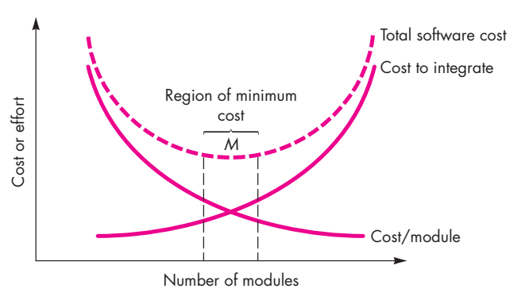
The Design Concepts
5. Modularity (Contd.):
Figure 2: Modularity and software cost

Slide 26
The Design Concepts
5. Modularity (contd.):
Referring to Figure 2, the effort (cost) to develop an individual software module does decrease as the total number of modules increases.
Given the same set of requirements, more modules means smaller individual size.
However, as the number of modules grows, the effort (cost) associated with integrating the modules also grows.
These characteristics lead to a total cost or effort curve shown in the figure 2.
There is a number, M, of modules that would result in minimum development cost, but we do not have the necessary sophistication to predict M with assurance.

Slide 27
The Design Concepts
5. Modularity (contd.):
We modularize a design (and the resulting program) so that
development can be more easily planned;
software increments can be defined and delivered;
changes can be more easily accommodated;
testing and debugging can be conducted more efficiently, and
long-term maintenance can be conducted without serious side effects.

Slide 28
The Design Concepts
6. Information Hiding:
The principle of information hiding suggests that modules should be specified and designed so that information contained within a module is inaccessible to other modules that have no need for such information.
The use of information hiding as a design criterion for modular systems provides the greatest benefits when modifications are required during testing and later during software maintenance.
Because most data and procedural detail are hidden from other parts of the software, inadvertent errors introduced during modification are less likely to propagate to other locations within the software.

Slide 29
The Design Concepts
7. Functional Independence:
The concept of functional independence is a direct outgrowth of separation of concerns, modularity, and the concepts of abstraction and information hiding.
Functional independence is achieved by developing modules with “single minded” function and an “aversion” to excessive interaction with other modules.
Stated another way, you should design software so that each module addresses a specific subset of requirements and has a simple interface when viewed from other parts of the program structure.
Independence is assessed using two qualitative criteria: cohesion and coupling.
Cohesion is an indication of the relative functional strength of a module.
Coupling is an indication of the relative interdependence among modules.

Slide 30
The Design Concepts
7. Functional Independence (contd.):
Cohesion is a natural extension of the information-hiding concept.
A cohesive module performs a single task, requiring little interaction with other components in other parts of a program.
Stated simply, a cohesive module should (ideally) do just one thing.
Although you should always strive for high cohesion (i.e., single-mindedness), it is often necessary and advisable to have a software component perform multiple functions.

Slide 31
The Design Concepts
7. Functional Independence (contd.):
Coupling is an indication of interconnection among modules in a software structure.
Coupling depends on the interface complexity between modules, the point at which entry or reference is made to a module, and what data pass across the interface.
In software design, you should strive for the lowest possible coupling.
Simple connectivity among modules results in software that is easier to understand and less prone to a “ripple effect”, caused when errors occur at one location and propagate throughout a system.

Slide 32
The Design Concepts
8. Refinement:
Refinement is actually a process of elaboration.
You begin with a statement of function (or description of information) that is defined at a high level of abstraction.
That is, the statement describes function or information conceptually but provides no information about the internal workings of the function or the internal structure of the information.
You then elaborate on the original statement, providing more and more detail as each successive refinement (elaboration) occurs.

Slide 33
The Design Concepts
8. Refinement (Contd.):
Abstraction and refinement are complementary concepts.
Abstraction enables you to specify procedure and data internally but suppress the need for “outsiders” to have knowledge of low-level details.
Refinement helps you to reveal low-level details as design progresses.
Both concepts allow you to create a complete design model as the design evolves.

Slide 34
The Design Concepts
9. Aspects:
An aspect is a representation of a crosscutting concern.
A crosscutting concern is some characteristic of the system that applies across many different requirements.
10. Refactoring:
An important design activity suggested for many agile methods, refactoring is a reorganization technique that simplifies the design (or code) of a component without changing its function or behavior.
Refactoring is the process of changing a software system in such a way that it does not alter the external behavior of the code [design] yet improves its internal structure.

Slide 35
The Design Concepts
11. Design Classes:
The requirements model defines a set of analysis classes.
Each describes some element of the problem domain, focusing on aspects of the problem that are user visible.
The level of abstraction of an analysis class is relatively high.
As the design model evolves, you will define a set of design classes that refine the analysis classes by providing design detail that will enable the classes to be implemented, and implement a software infrastructure that supports the business solution.

Slide 36
The Design Concepts
11. Design Classes (contd.):
Five different types of design classes, each representing a different layer of the design architecture, can be developed:
User interface classes define all abstractions that are necessary for human computer interaction (HCI). In many cases, HCI occurs within the context of a metaphor (e.g., a checkbook, an order form, a fax machine), and the design classes for the interface may be visual representations of the elements of the metaphor.
Business domain classes are often refinements of the analysis classes defined earlier. The classes identify the attributes and services (methods) that are required to implement some element of the business domain.

Slide 37
The Design Concepts
11. Design Classes (contd.):
Process classes implement lower-level business abstractions required to fully manage the business domain classes.
Persistent classes represent data stores (e.g., a database) that will persist beyond the execution of the software.
System classes implement software management and control functions that enable the system to operate and communicate within its computing environment and with the outside world.

Slide 38
The Design Concepts
11. Design Classes (contd.):
Each design class should be reviewed to ensure that it is “well-formed.” The four characteristics of a well-formed design class are:
Complete and sufficient. A design class should be the complete encapsulation of all attributes and methods that can reasonably be expected (based on a knowledgeable interpretation of the class name) to exist for the class.
For example, the class Scene defined for video-editing software is complete only if it contains all attributes and methods that can reasonably be associated with the creation of a video scene.
Sufficiency ensures that the design class contains only those methods that are sufficient to achieve the intent of the class, no more and no less.

Slide 39
The Design Concepts
11. Design Classes (contd.):
Primitiveness. Methods associated with a design class should be focused on accomplishing one service for the class. Once the service has been implemented with a method, the class should not provide another way to accomplish the same thing.
For example, the class VideoClip for video-editing software might have attributes start-point and end-point to indicate the start and end points of the clip (note that the raw video loaded into the system may be longer than the clip that is used).
The methods, setStartPoint() and setEndPoint(), provide the only means for establishing start and end points for the clip.

Slide 40
The Design Concepts
11. Design Classes (contd.):
High cohesion. A cohesive design class has a small, focused set of responsibilities and single-mindedly applies attributes and methods to implement those responsibilities.
For example, the class VideoClip might contain a set of methods for editing the video clip.
As long as each method focuses solely on attributes associated with the video clip, cohesion is maintained.
Low coupling. Within the design model, it is necessary for design classes to collaborate with one another. If a design model is highly coupled, the system is difficult to implement, to test, and to maintain over time.

Slide 41
The user interface
User interfaces should be designed to match the skills, experience and expectations of its anticipated users.
System users often judge a system by its interface rather than its functionality.
A poorly designed interface can cause a user to make catastrophic errors.
Poor user interface design is the reason why so many software systems are never used.
41

Slide 42
Importance of User Interface
“Most important part of any computer system”
“Interface is the system for most users”
Increasingly important
GUIs a big improvement over previous approaches
Platforms (e.g. Mac/ Microsoft) have style guides
50% of code devoted to interface
Interface should “disappear” – users can focus on their task, not the interface
Biggest enemy of good interface design is time
42

Slide 43
Graphical user interfaces
Most users of business systems interact with these systems through graphical interfaces although, in some cases, legacy text-based interfaces are still used
Characteristic | Description
Windows | Multiple windows allow different information to be displayed simultaneously on the user’s screen.
Icons | Icons different types of information. On some systems, icons represent files; on others, icons represent processes.
Menus | Commands are selected from a menu rather than typed in a command language.
Pointing | A pointing device such as a mouse is used for selecting choices from a menu or indicating items of interest in a window.
Graphics | Graphical elements can be mixed with text on the same display.
43

Slide 44
Design principles
User familiarity
The interface should be based on user-oriented
terms and concepts rather than computer concepts. For example, an office system should use concepts such as letters, documents, folders etc. rather than directories, file identifiers, etc.
Consistency
The system should display an appropriate level
of consistency. Commands and menus should have the same format, command punctuation should be similar, etc.
Minimal surprise
If a command operates in a known way, the user should be able to predict the operation of comparable commands
8

Slide 45
Design principles
Recoverability
The system should provide some resilience to
user errors and allow the user to recover from errors. This might include an undo facility, confirmation of destructive actions, 'soft' deletes, etc.
User guidance
Some user guidance such as help systems, on-line
manuals, etc. should be supplied
User diversity
Interaction facilities for different types of user should be supported. For example, some users have seeing difficulties and so larger text should be available

Slide 46
Design issues in UIs
Two problems must be addressed in interactive systems design
How should information from the user be provided to the computer system?
How should information from the computer system be presented to the user?
User interaction and information presentation may be integrated through a coherent framework such as a user interface metaphor.

Slide 47
Interaction styles
Direct manipulation: The user interacts directly with objects on the screen, such as a mouse, touch screen ..etc.
Menu selection: The user selects a command from a list of possibilities ( a menu).
Form fill-in: The user fills in the fields of a form
Command language: The user issues a special command and associated parameters to instruct the system what to do
Natural language: The user issues a command in natural language that must be parsed into command language
11

Slide 48
Interaction styles
Interaction style
Direct manipulation
Main advantages
Main disadva ntages
Application examples
Video games CAD systems
Fast and intuitive interaction
Easy to learn
May be hard to implement. Only suitable where there is a visual metaphor for tasks and objects.
Slow for expe rienced users. Can beco me complex if many menu options.
Takes up a lot of screen space. Causes problems where user options do not match the form fields.
Hard to learn.
Poor error manage ment.
Menu selection
Avoids user error Little typing required
M ost general-
purpose systems
Form fill-in
Simple data entry Easy to learn Checkab le
Stock control, Personal loan proces sing
Command language
Powerful and flexible
Op erating systems, Command and control systems
Information retrieval systems
Natural language
Accessible to casual users
Easily extended
Requires more typing.
Natural language und erstanding systems are un reliable.
12

Slide 49
Direct manipulation
Advantages
Users feel in control of the computer.
User learning time is relatively short.
Users get immediate feedback on their actions so mistakes can
be quickly detected and corrected.
Disadvantages
The derivation of an appropriate information space model can
be very difficult
Given that users have a large information space, what facilities for navigating around that space should be provided?
Direct manipulation interfaces can be complex to program and make heavy demands on the computer system
13

Slide 50
Control panel interface
Title
JSD. example
Grid
Busy
Method
JSD
OUIT
Type
Network
Units
cm
Selection
Process
Reduce
Full
PRINT
NODE
LINKS
FONT
LABEL
EDIT
Figure 3: Control Panel Interface

Slide 51
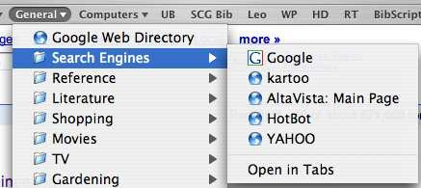
Menu systems
Users make a selection from a list of possibilities.
The selection may be made by pointing and clicking with a
mouse, using cursor keys or by typing the name of the selection
May make use of simple-to-use terminals such as touchscreens
Figure 4: Menu system

Slide 52
Menu systems
Advantages
Users need not remember command names
Typing effort is minimal
User errors are trapped by the interface
Context-dependent help can be provided.
Problems
Actions which involve logical conjunction (and) or disjunction (or) are awkward to represent
Menu systems are best suited to presenting a small number of choices. If there are many choices, some menu structuring facility must be used
16

Slide 53
Form-based interface
NEW BOOK
Title
ISBN
Author
Price
Publisher
Publication date
Number of copies
Edition
Classification
Loan status
Order status
Date of purchase
17
Figure 5: Form Based Interface

Slide 54
Practice Questions
What Is System Design?
What is load balancing, and why is it important in system design?
How are performance and scalability related to each other?
How do you approach system design?
Which is the primary tool for structured design?
Can you name some metrics for measuring system performance?
There are basic approaches in Integration testing: Top down, bottom up. Discuss each one of them.
What are the pros and cons of bottom-up models versus top-down models?

Slide 55
THANKS
55

